Slide 1

Resilience and network connectivity in the Balkans
Umut Türk , John Östh , Aura Reggiani , Jelena J. Stanković, Ivana Marjanović , Marija Džunić, Marina Stanojević & Marina Toger
ERSA, ATHENS, 2025

Slide 2

Motivation and research idea #1
Economic resilience is usually measured either as the ability to withstand a shock (engineering resilience) or the effects of a shock after the triggering event.
It has been shown that regional variation in resilience is related to network connectivity and accessibility since the effects of a shock either can be propagated or reduced.
In most cases economic resilience is measured on national scale since harmonizing data is available over time and in regions.
We are testing a novel approach to facilitate the study of resilience and networks in international contexts also where data is scarce

Slide 3
Motivation and research idea #2
Our suggestion:
  Long term economic resilience can be understood in terms of over-time population change
  Using longitudinal census data we can generate data that captures regional development also in different countries
  Using Open street Map or equivalent sources allow us generate a transport network that connects the different regions
  Additional variables describing the composition of urban features and economic opportunities can also be generated using open map resources.
Our idea:
  Using network distance between all pairs of origins and destinations, and data describing the population at destination, makes it possible to estimate the potential accessibility to all included destinations from all origins.
  By using the population change as a dependent variable, contextual variables generated from open data for both origin and destination and the potential accessibility as weight we can study the network and regressors effect on population change.

Slide 4
Data and selection
The following steps were conducted to collect data and select sites for inclusion in the study
Using population grid (Eurostat) we selected all urban settlements having at least 50000 inhabitants within a 20km radius
Download data from Open street map for all countries /regions in Western Balkan (Serbia, Croatia, Slovenia, Monte Negro, Kosovo, Bosnia, North Macedonia and Albania)
  Road network
  POIs
Collect population census data for the included cities (national census services)

Slide 5
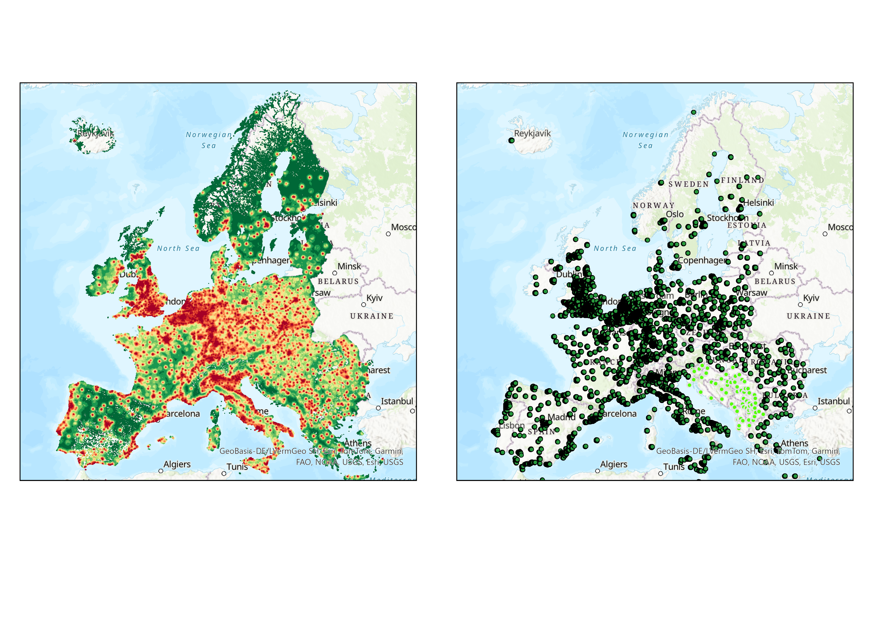
First – selecting regions – map of population in Europe (EU+)

Slide 6
First – selecting regions – map of population in Europe (EU+)
Left map:
  Population per km2
  Distance needed to reach 50000 inhab, from each km unit
  Longer distances green, shorter distances = red
Right map:
  Units with shorter distances than 20km are illustrated as deep green
  Units in Western Balkan are light green

Slide 7
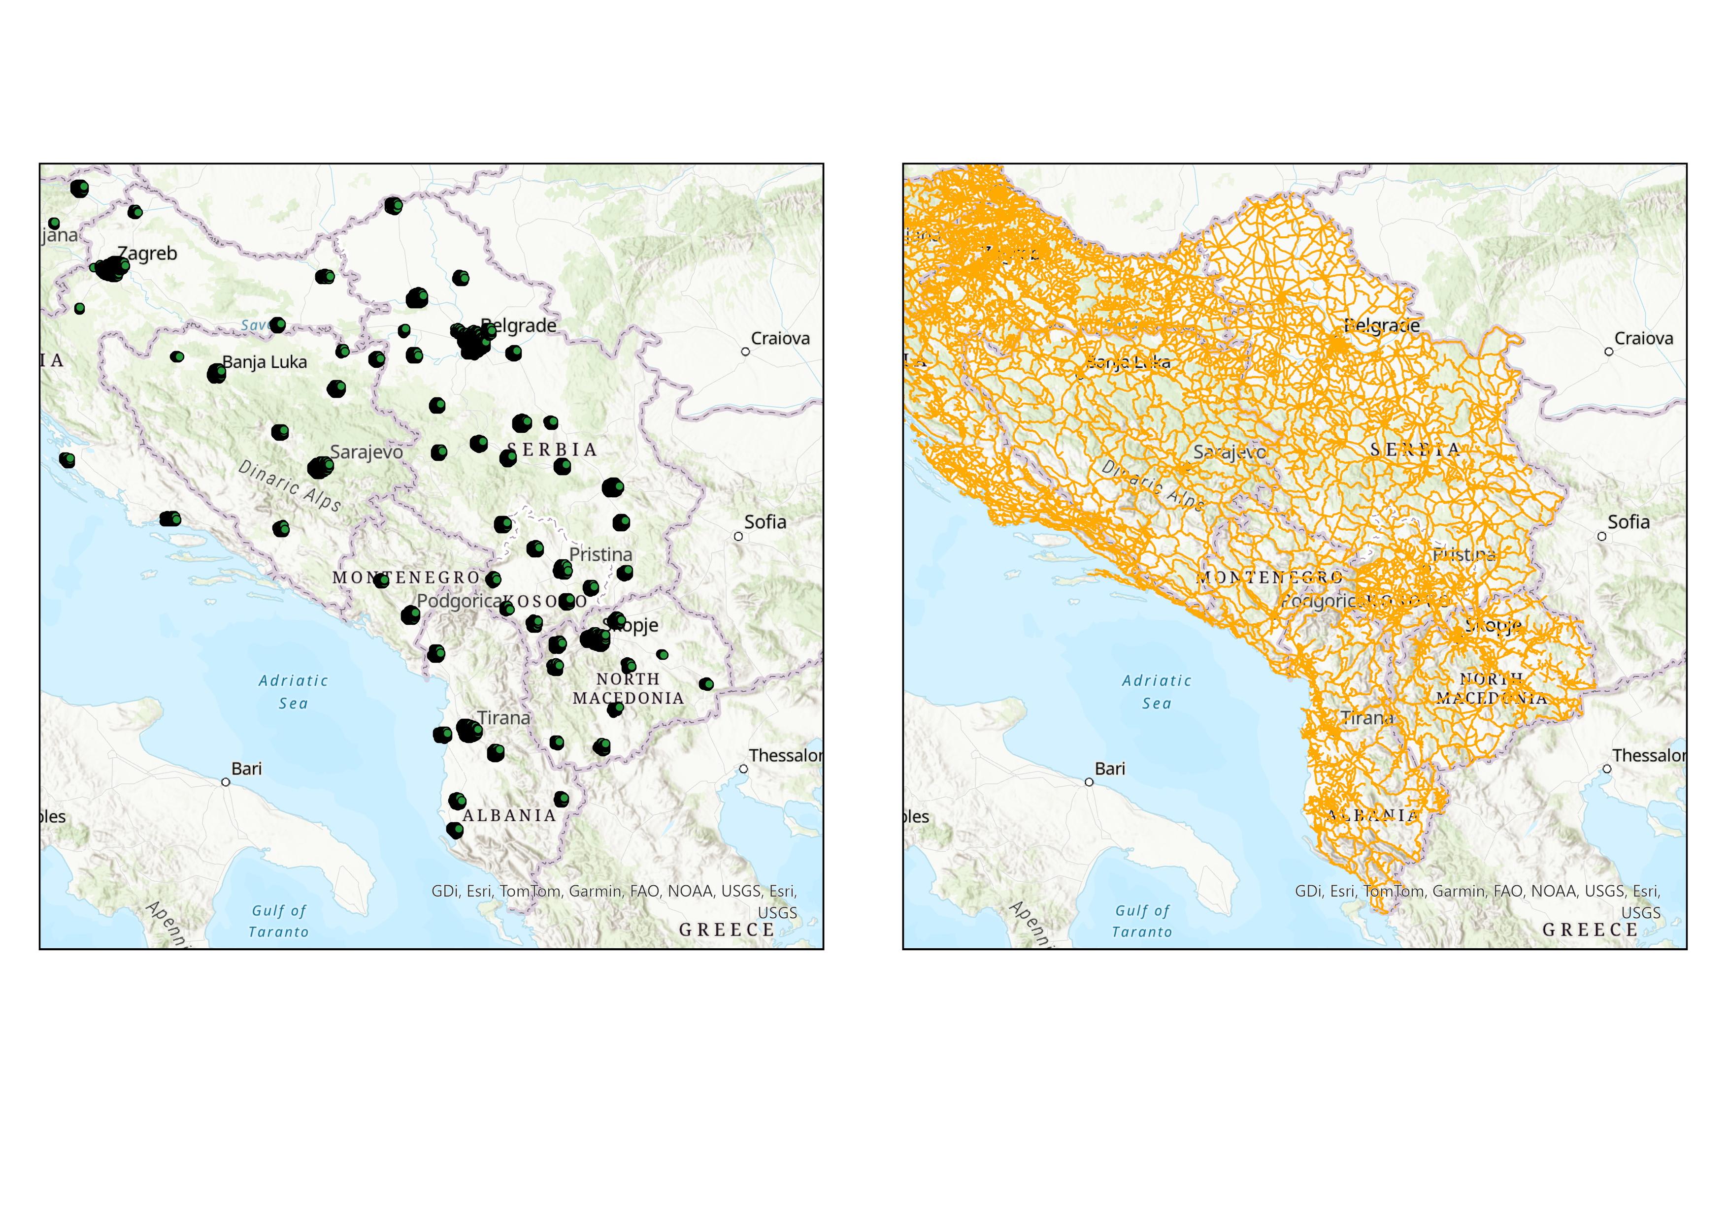
Cities in Western Balkan
65 cities in western Balkan
(at least pop 50k within 20km)
  Located in Slovenia, Croatia, Bosnia, Kosovo, Albania, Monte-Negro, North Macedonia and Serbia
  All primary, secondary and tertiary roads in all parts of the region are included
  Using network GIS we calculate the shortest road distance between each city (mid point of selected cities) and destinations
    65 * 65 cities

Slide 8
There is no pan-regional data available so…
Data is derived from Eurostat, Open street map (OSM), or national census statements
OSM is used to describe infrastructure and POI
  POI are all Points Of Interests listed in OSM for Western Balkan
  There are approximately 2 million POI in the region
  POI lists schools, banks, cafés, playgrounds, etc
Using the obtained datasets we generated the following variables…

Slide 9
Dataset part 1
Population change
  For each identified urban area, the official between-census population change is expressed as percent
  Population censuses are most often representing 2011 and 2021, but in some countries 2001 or 2023 are used (all determined by the census dates in each country)
Destination population gravity
  Between each O-D pair:
  Three specifications of spatial interaction.
  Since we have no flow data between OD pairs, we use the mathematical specifications of distance decay for three forms:
    Negative exponential
    Log normal
    Inverse distance

Slide 10
Dataset part 2 gravity between pairs (OD)
Negative exponential
  Opportunity in D is estimated as:
  Latest Pop_{j} * exp(d_{ij}*-β)
  Functional form replicates short to medium commuting distances
Log-Normal
  Opportunity in D is estimated as:
  Latest Pop_{j} * exp(ln(d_{ij})^2*-β)
  Functional form replicates regional travel and migration (similar as power function)
Inverse distance
  Opportunity in D is estimated as:
  Latest Pop_{j} * 1/ (d_{ij})
  Function common in Geo computation but not in networks
The beta value specification is based on the assumption that a median mobility distance can be approximated
  We suggest 50000m as median
  Calculation of beta – (see Östh et al. 2014, 2016)

Slide 11
Dataset part 3 regressors
Using OSM (Open Street Map data), we generate kernel density functions to estimate the concentration of:
  Culture and hospitality
  Financial establishments
  Child-rearing
  All objects
Values for each city is estimated at the city-midpoint
  Using the most recent census function we classify the relationship between pairs of OD as having
    Same language (can be same or different)
  Line density
    Using the sum of infrastructure within 5km radius from the regional midpoints, we can establish a measure of infrastructure density and use as a proxy for urban density

Slide 12
Methods: short
We use WLS to study the relationship between over-time population change, network and contextual variables.
Since the data on population flows is not available for balkans, we assume that asymetries in population change between cities can be use as a crude measure.
Spatial interaction is defined as real road network between any pairs of cities (64X64 in total) with a decay function that ensures the spatial interaction decreases with distance. We use negative exponential, log-normal and inverse distance functions to test different spesifications.
Decay factor calculated by Half life models as detailed by Östh et al. 2016
Notes:
Östh, J., Lyhagen, J., & Reggiani, A. (2016). A new way of determining distance decay parameters in spatial interaction models with application to job accessibility analysis in Sweden. European Journal of Transport and Infrastructure Research, 16(2), 344-363.

Slide 13
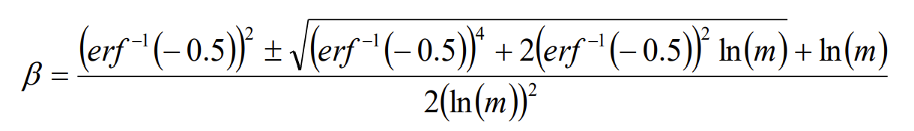
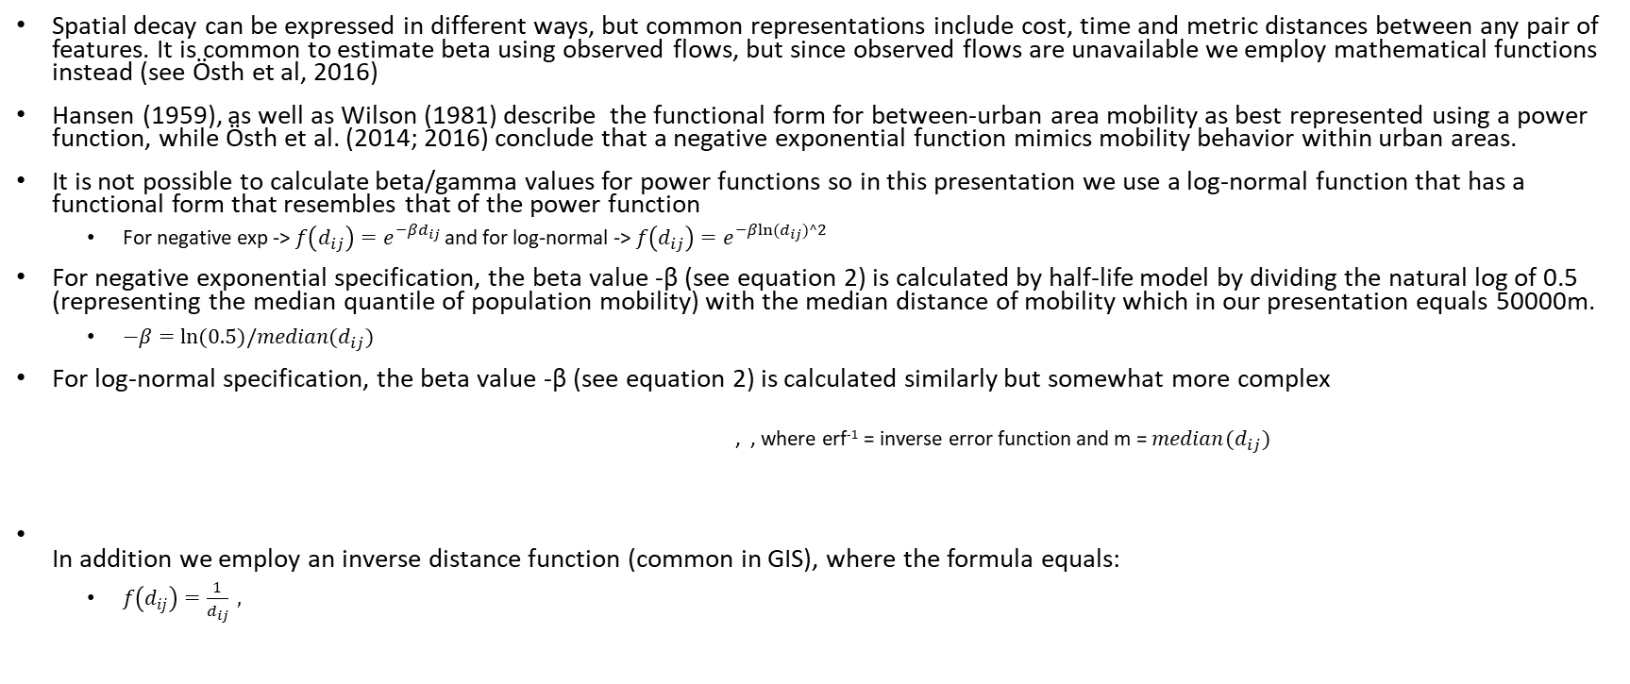
Methods: spatial interaction
Spatial decay can be expressed in different ways, but common representations include cost, time and metric distances between any pair of features. It is common to estimate beta using observed flows, but since observed flows are unavailable we employ mathematical functions instead (see Östh et al, 2016)
Hansen (1959), as well as Wilson (1981) describe the functional form for between-urban area mobility as best represented using a power function, while Östh et al. (2014; 2016) conclude that a negative exponential function mimics mobility behavior within urban areas.
It is not possible to calculate beta/gamma values for power functions so in this presentation we use a log-normal function that has a functional form that resembles that of the power function
  For negative exp -> $f\left(d_{ij}\right)=e^{−βd_{ij}}$ and for log-normal -> $f\left(d_{ij}\right)=e^{−β{ln⁡(d}_{ij})^2}$
For negative exponential specification, the beta value -β (see equation 2) is calculated by half-life model by dividing the natural log of 0.5 (representing the median quantile of population mobility) with the median distance of mobility which in our presentation equals 50000m.
  $−β=ln⁡(0.5)/median(d_{ij})$
For log-normal specification, the beta value -β (see equation 2) is calculated similarly but somewhat more complex
  , , where erf⁻¹ = inverse error function and m = $median(d_{ij})$
In addition we employ an inverse distance function (common in GIS), where the formula equals:
  $f\left(d_{ij}\right)=\frac{1}{d_{ij}} ,$
John, Ö., Lyhagen, J., & Reggiani, A. (2016). A new way of determining distance decay parameters in spatial interaction models with application to job accessibility analysis in Sweden. European Journal of Transport and Infrastructure Research, 16(2), 344-362.

Slide 14
Results

Slide 15
 | (1) | (2) | (3)
VARIABLES | Log Normal Specification | Negative Exponential Specification | Inverse Distance Specification
CultKernOrigin | 9.120*** | -0.914*** | 14.644***
 | (0.085) | (0.028) | (0.035)
FinanceKerOrigin | 29.869*** | 29.621*** | 35.172***
 | (0.130) | (0.035) | (0.052)
KidsKernOrigin | -39.096*** | -29.181*** | -57.151***
 | (0.103) | (0.034) | (0.037)
LineD5kmOrigin | 0.984*** | 1.136*** | 1.265***
 | (0.003) | (0.001) | (0.001)
CultKerndest | 12.758*** | 25.646*** | 17.154***
 | (0.080) | (0.028) | (0.033)
FinanceKerdest | -4.758*** | -13.673*** | -5.857***
 | (0.069) | (0.018) | (0.030)
KidsKerndest | -11.974*** | -23.156*** | -20.795***
 | (0.081) | (0.029) | (0.034)
LineD5kmdest | -0.068*** | -0.042*** | 0.079***
 | (0.003) | (0.001) | (0.001)
samelang | 1.694*** | 0.001 | 2.294***
 | (0.017) | (0.005) | (0.007)
Constant | -16.233*** | -15.666*** | -18.365***
 | (0.028) | (0.009) | (0.010)
Observations | 1,079,746 | 11,942,202 | 5,872,167
R-squared | 0.348 | 0.417 | 0.865
Standard errors in parentheses
*** p<0.01, ** p<0.05, * p<0.1

Slide 16
Interpretation
Model Definition and Weighting:
The three models are based on importance weighting in the regressions.
Variables are defined for both origin (home) and destination cities.
Lognormal Specification Findings:
Population Resilience:
  Resilience, defined as population change over time, increases with cultural amenities in both origin and destination cities.
Financial Institutions:
  A high concentration of financial institutions in the origin city is positively associated with resilience.
  Conversely, a high concentration of financial institutions in spatially connected destination cities is negatively associated with resilience at the origin.
Child-Rearing Facilities:
  A high presence of child-rearing facilities (the variable "kids") is negatively associated with resilience when abundant in both the origin and its spatially connected cities.
Urbanization (Road Network Density):
  Road network density (a proxy for urbanization) is positively associated with resilience in the origin city.
  However, road density in spatially connected destinations is negatively associated with resilience at the origin.
Social Connection (Common Language):
  Sharing the same language with spatially connected cities enhances resilience in the origin city.
Negative Exponential Specification Findings:
Similar patterns are observed with this specification, but there are some differences:
  When distance is perceived as having a negative exponential effect (shorter distances are more significant), cultural amenities in spatially connected destinations have a positive correlation with resilience.
  Common language does not significantly impact resilience in this specification.
Inverse Distance Specification:
Results for the inverse distance specification are similar to those for the lognormal specification.

Slide 17
Results continued
If we save the predicted population change for each OD (65x65) and aggregate on origin level (average change) we can:
  Test which of the three functional forms did the best job to predict the over time population change
  Since the population change variable is normally distributed we can compare predictions to observed change using a Pearson correlation
  The results indicate that…

Slide 18
Pearson Correlation
 | predictedLogNormal | predictedNegativeExponential | predictedIDW | Perchange Origin
predictedLogNormal | 1
predictedNegativeExponential | 0.9776* | 1
predictedIDW | 0.9892* | 0.9524* | 1
Perchange Origin | 0.3809* | 0.3789* | 0.3691* | 1
* p<0.01
Notes:
The table presents the Pearson correlation between predicted values from the three models and spatial interaction, defined by lognormal, negative exponential, and inverse distance weights. Significant and moderate correlations are observed, with higher correlations for the lognormal specification, as suggested by the literature. Additionally, the findings indicate a positive and significant correlation between spatial connectivity and population resilience in Balkan cities.

Slide 19
Rank table – top 16 regions (Growing over time)
Name of city | Rank population development | Rank log-normal | Rank neg-exponential | Rank IDW
Pristina | 1 | 9 | 12 | 10
Podgorica | 2 | 10 | 11 | 9
Durres | 3 | 5 | 7 | 4
Novi Sad | 4 | 3 | 3 | 3
Bijeljina | 5 | 23 | 22 | 24
Novi Pazar | 6 | 36 | 37 | 33
Ljubliana | 7 | 6 | 5 | 6
Skopje | 8 | 4 | 4 | 5
Belgrade | 9 | 2 | 2 | 2
Kranj | 10 | 63 | 65 | 63
Vlore | 11 | 39 | 52 | 37
Maribor | 12 | 13 | 8 | 12
Tirana | 13 | 1 | 1 | 1
Ferizaj | 14 | 42 | 40 | 45
Celje | 15 | 32 | 32 | 36
Nis | 16 | 8 | 9 | 7

Slide 20
Rank table – lower 16 regions (loosing population)
Name of city | Rank population development | Rank log-normal | Rank neg-exponential | Rank IDW
Shtip | 50 | 54 | 50 | 50
Kraljevo | 51 | 26 | 25 | 26
Subotica | 52 | 14 | 13 | 11
Leskovac | 53 | 33 | 35 | 31
Peja | 54 | 55 | 54 | 56
Zrenjanin | 55 | 29 | 23 | 29
Slavonski Brod | 56 | 21 | 19 | 25
Tuzla | 57 | 45 | 33 | 49
Rijeka | 58 | 17 | 18 | 17
Mostar | 59 | 11 | 24 | 8
Gjakova | 60 | 64 | 64 | 64
Prizren | 61 | 46 | 47 | 46
Bitola | 62 | 49 | 48 | 43
Sarajevo | 63 | 12 | 10 | 14
Zenica | 64 | 38 | 36 | 39
Shkoder | 65 | 30 | 28 | 30

Slide 21
Conclusion
We have suggested a method for the analysis of resilience and networks in regions where data is scarce
Data is derived from open sources or national/EU censuses
Spatial interaction in network often departs from statistical analysis of flow data – using an alternative formulation we have an opportunity to estimate interaction
We find that a log-normal functional form works best to describe spatial interaction,…
…and we find that the method is doing affair job in explaining the long term population changes in the Western Balkans

