Slide 1



Resource Efficiency and Urban Quality of Life
A Multidimensional Sustainability Assessment in Serbia
Sonja Jovanović, Vesna Janković Milić, Marija Džunić
Faculty of Economics, University of Niš, Serbia

Slide 2

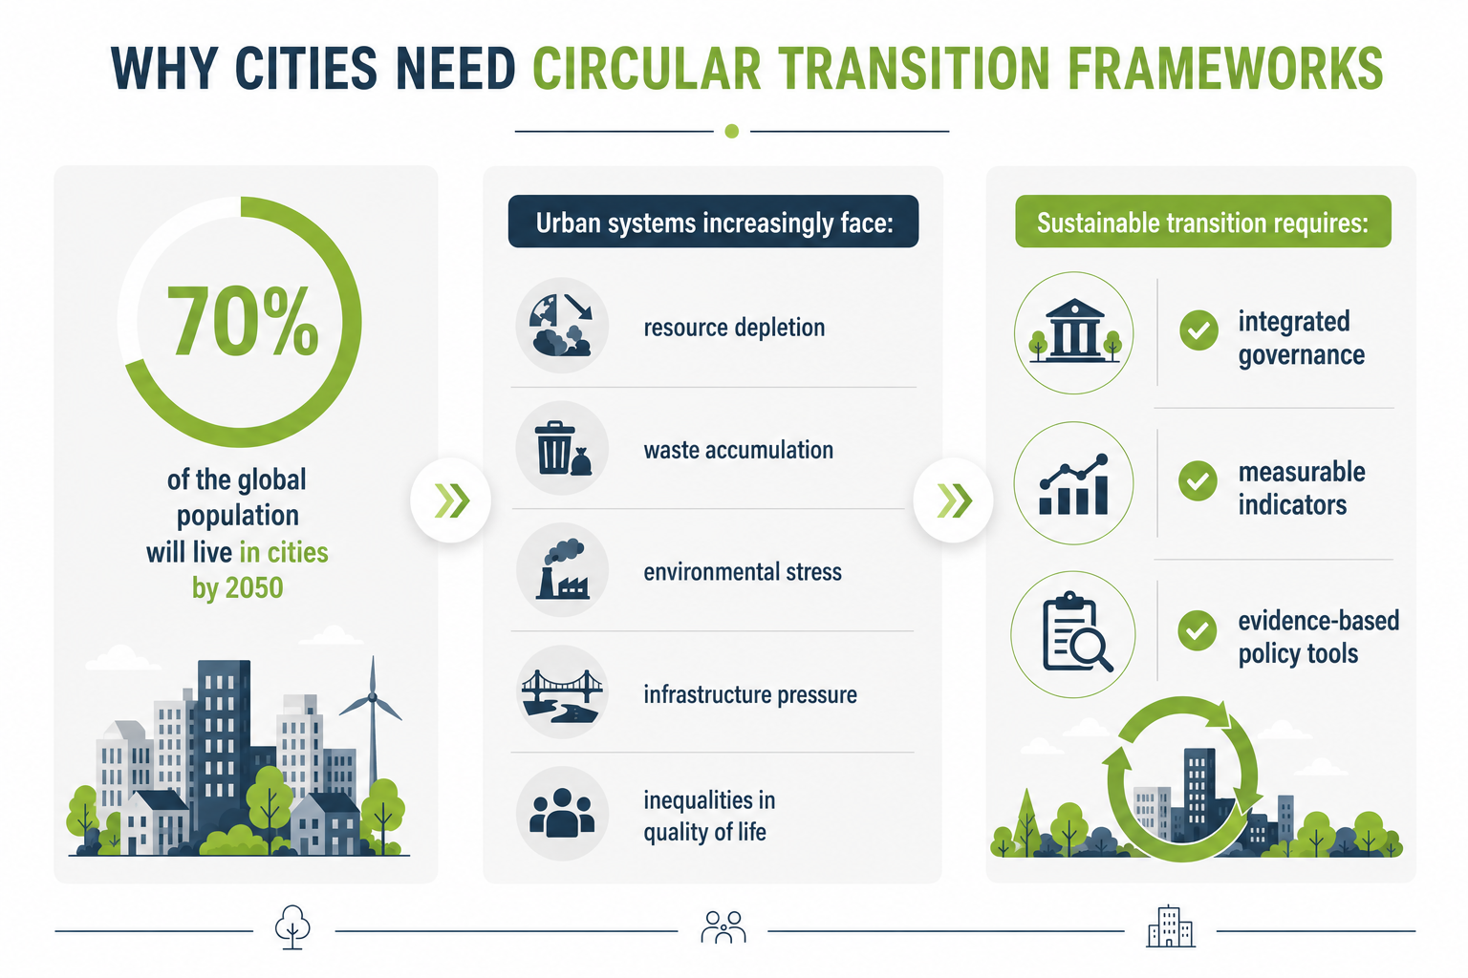

Slide 3
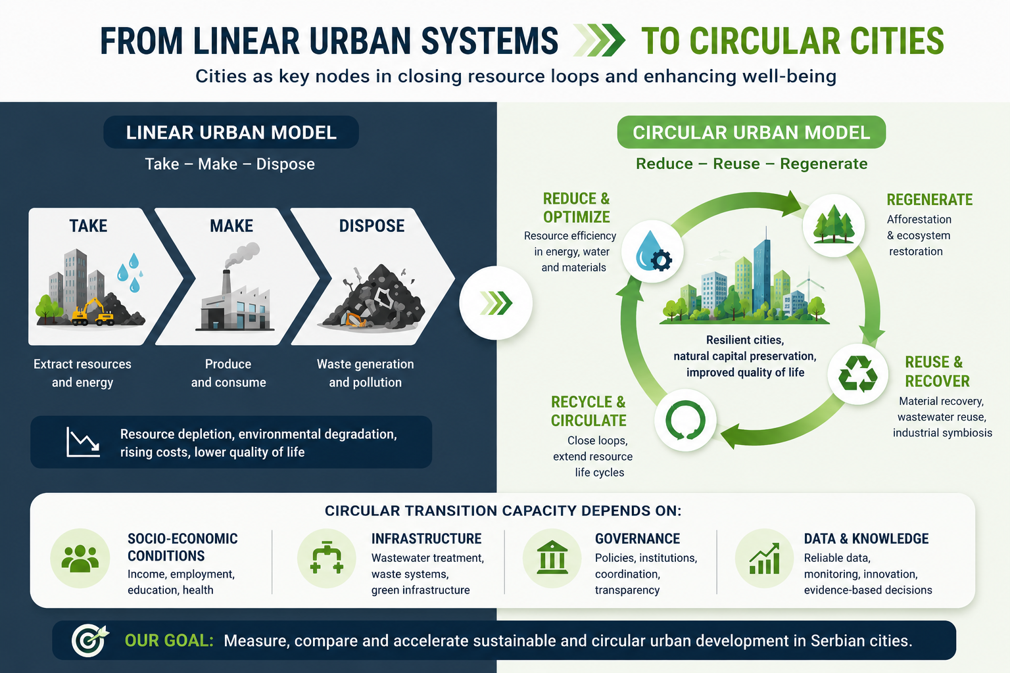

Slide 4

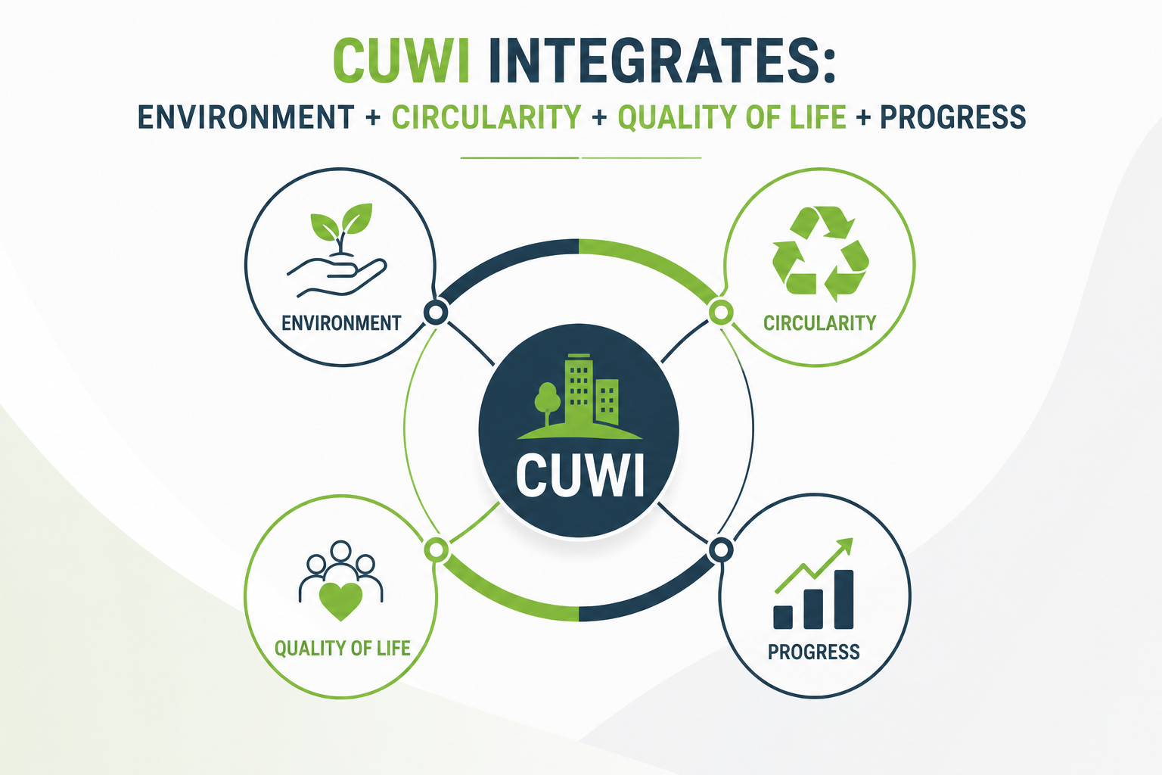

Single indicators cannot capture:
environmental performance
social well-being
regenerative capacity
adaptive dynamics
Composite indices enable:
✔ integration of heterogeneous data
✔ comparison across cities
✔ benchmarking and monitoring
✔ evidence-based decision-making
Existing indices:
UN Prosperity Index Cities in Motion Index Sustainable Cities Index
BUT:
Most remain fragmented and insufficiently connected to circular economy dynamics.

Slide 5
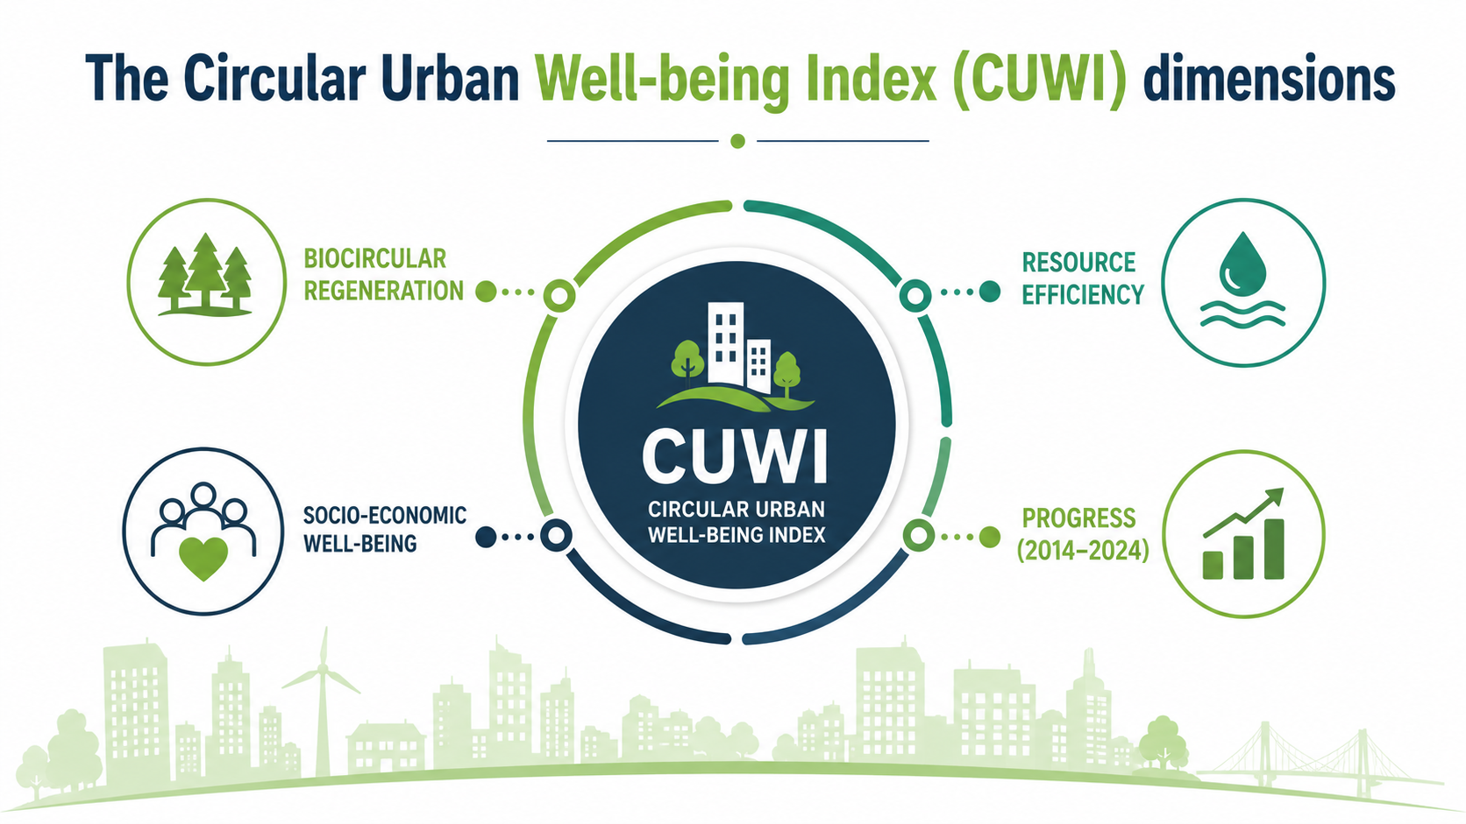

Slide 6
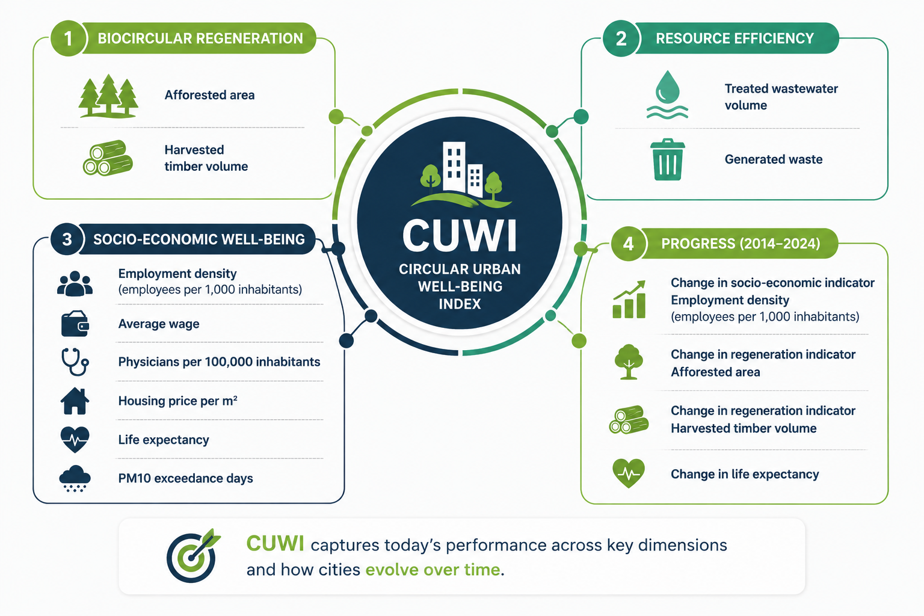

Slide 7
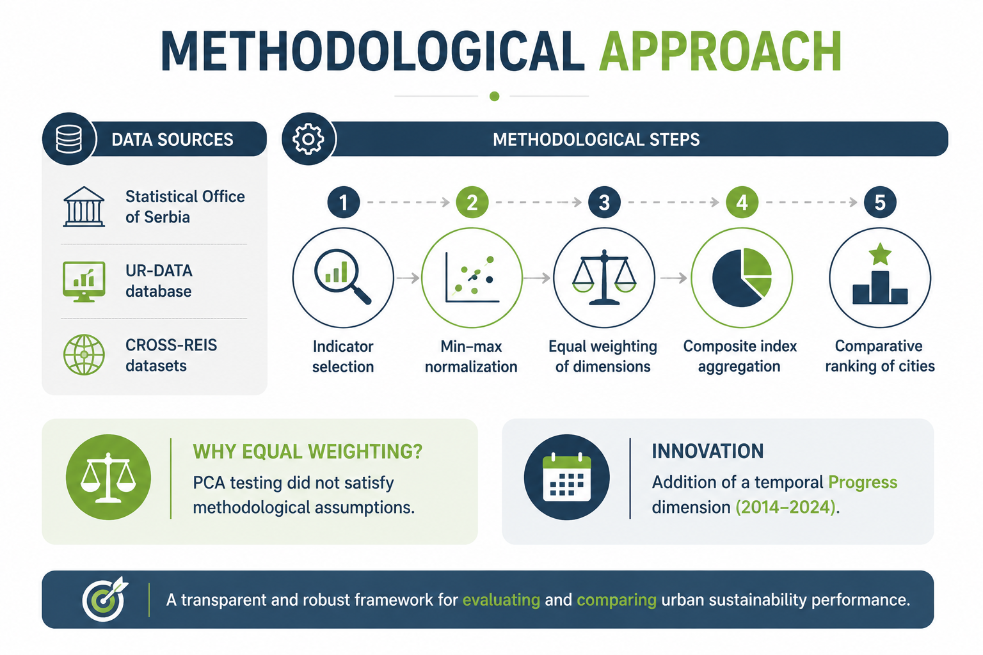

Slide 8
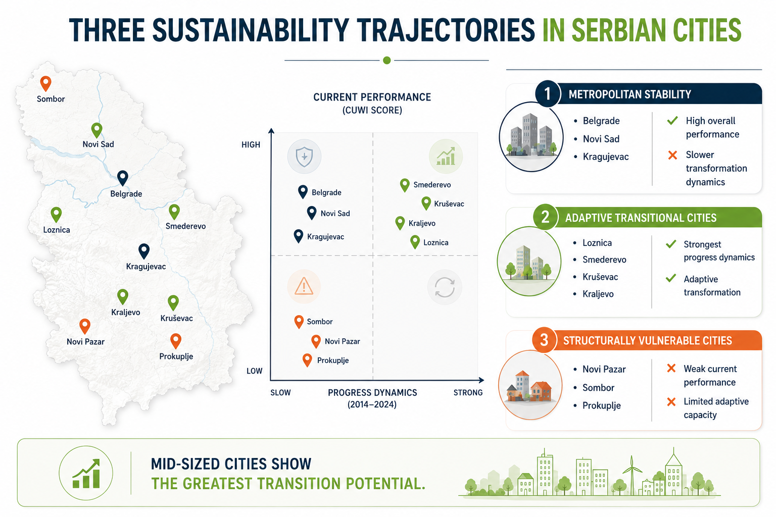

Slide 9
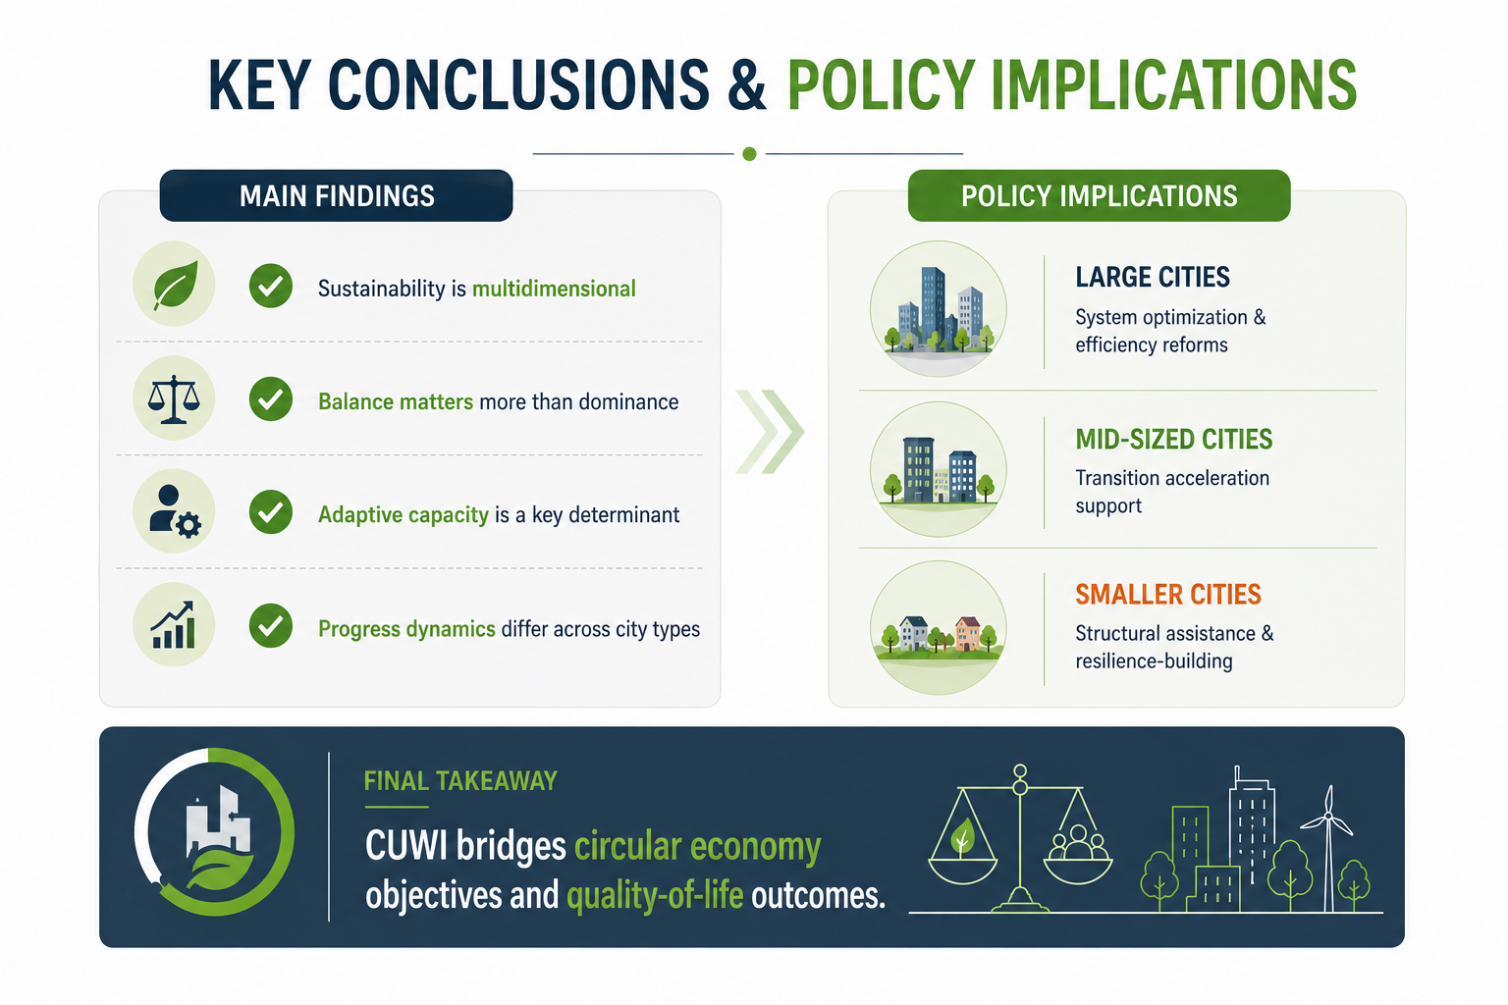

Slide 10

Sustainable cities are not defined only by growth — but by their capacity to regenerate and adapt.
Thank You
www.crossreis.com info@crossreis.com

